Slide 1
General Stakeholder Group – Q3 2019 Meeting
9/19/2019

Slide 2
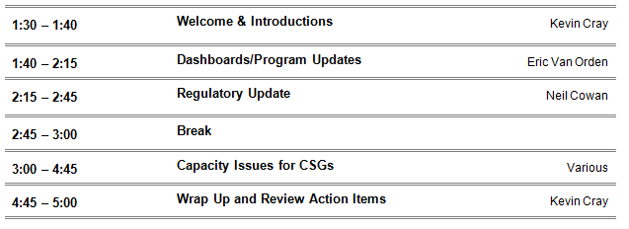
Agenda

Slide 3
Dashboards

Slide 4
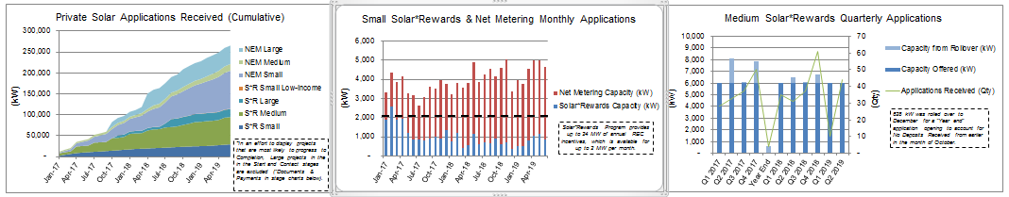
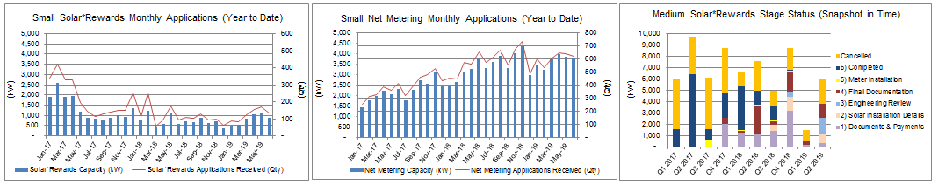
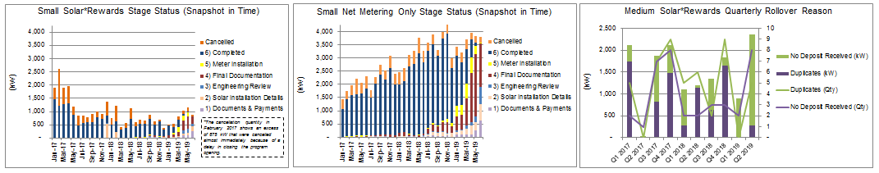
Solar*Rewards – Quarterly Dashboard
Combined Stakeholder Meeting - 2019 Q2 – September 19, 2019
*Source data was extracted on June 31, 2019. There may be variances in future dashboards from similar periods, particularly the "Stage Status" graphs that are a snapshot in time.

Slide 5
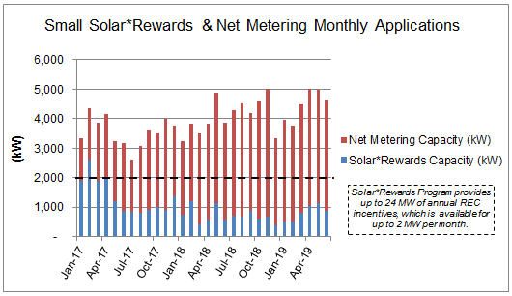
Solar*Rewards & Net Metering Only – Small
Approx. average 1 MW of Solar*Rewards & 3 MW of NEM Only monthly applications
Combined Stakeholder Meeting - 2019 Q2 – September 19, 2019
*Source data was extracted on June 31, 2019. There may be variances in future dashboards from similar periods, particularly the "Stage Status" graphs that are a snapshot in time.

Slide 6
Solar*Rewards – Medium
Dozens of projects were cancelled by the customer or solar developer
Combined Stakeholder Meeting - 2019 Q2 – September 19, 2019
Solar*Rewards Medium Application Status
Check with COSSA 2-18
Capacity (MW)
*Source data was extracted on June 31, 2019. There may be variances in future dashboards from similar periods, particularly the "Stage Status" graphs that are a snapshot in time.

Slide 7
Record Breaking On-site Solar Milestones & Projects
Combined Stakeholder Meeting - 2019 Q2 – September 19, 2019
All programs
50,000 On-site installations (June)
Mix of Solar*Rewards Large + Medium
Largest rooftop installation was completed at Amazon in Thornton, CO
19 acres on a rooftop of 17,280 panels for a total of ~6 MW (July)
Large Solar*Rewards
Largest individual customer-sited solar array was connected at IBM in Boulder
55 acres of 25,000 panels for a total of ~10 MW (July)

Slide 8
Solar*Rewards Community – Operational Status
More than 25MW of solar gardens became operational since Year End 2018
Combined Stakeholder Meeting - 2019 Q2 – September 19, 2019
Status (as of June 30, 2019) | Project sites | MW
Pre-Interconnection Study | 46 | 77.3
Construction | 11 | 20.6
Operational | 65 | 81.6
Totals | 122 | 179.5

Slide 9
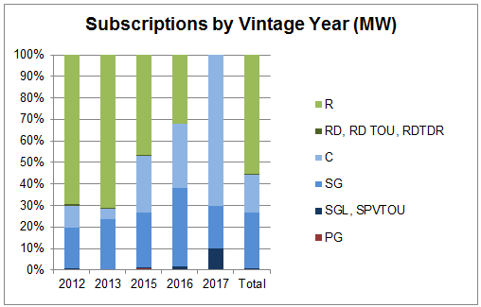
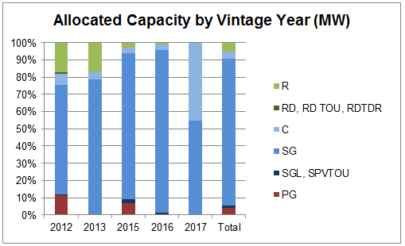
Solar*Rewards Community – Subscribers
Combined Stakeholder Meeting - 2019 Q2 – September 19, 2019
*Source data was extracted on June 31, 2019. There may be variances in future dashboards from similar periods, particularly the "Stage Status" graphs that are a snapshot in time.

Slide 10
On-site Storage - Operational Status
21 pre-approved battery “packages”, which then require line diagrams specific to the application
Combined Stakeholder Meeting - 2019 Q2 – September 19, 2019
Cumulative On-site Battery Storage Project Status by Application Date
Project Count
Status (as of June 30, 2019) | Project sites
Early Application (Documents, Installation Details, & Review) | 52
Pending Installation (Final Documentation & Meter Installation) | 70
Completed | 289
Totals | 411

Slide 11
Solar Garden & On-site Solar
Program Updates

Slide 12
Solar*Rewards Subscriber Operations Updates
Combined Stakeholder Meeting - 2019 Q2 – September 19, 2019
Dynamic Reporting
Future RFP subscriber rules
New subscriber entry requirements (3,199kWh or less)
Data Request Form Updates
Bill Sync Date Adjustment
Telemetry Cost Update

Slide 13
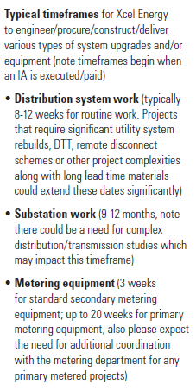
Combined Stakeholder Meeting - 2019 Q2 – September 19, 2019
Holistic Process/Timeline
Engineering Reviews
  Level 1: <10 kW
    15 day screen for system impacts
  Level 2:
    Up to 60 days to determine low system impact mitigation upgrades
    Relay settings, fuses, etc.
  Level 3:
    Undetermined timeline to analyze full system impacts and mitigation steps to maximize available capacity
Distribution only vs. Substation Impact
Construction and Witness Test

Slide 14
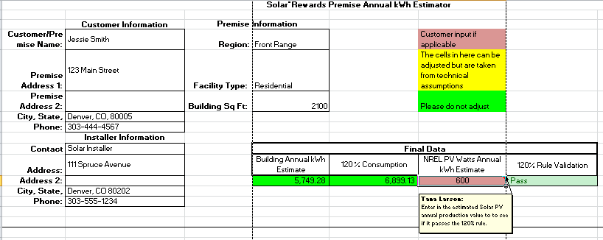
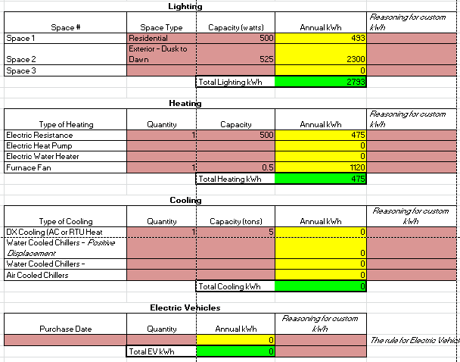
Energy Analysis & Adders Tools
Combined Stakeholder Meeting - 2019 Q2 – September 19, 2019
Consistent Usage Estimates
Electrification Adders

Slide 15
Regulatory Update

Slide 16
Regulatory Update
2020-21 RES Plan (Proceeding No. 19A-0369E)
  10/23 Answer Testimony
  11/18 Rebuttal Testimony
  11/25 Settlement
  12/10-12 Hearing
Electric Rate Review (Proceeding No. 19AL-0268E)
Electric Vehicle Commercial Rate (Proceeding No. 19AL-0290E)
Rulemaking (Proceeding No. 19R-0096E)
16

Slide 17
Capacity Issues for CSGs

Slide 18
A Case Study – Imboden Substation
Where is the Imboden Substation?
Some history
Growth of CSGs at Imboden
Current Status
HB19-1003
Other venues

Slide 19
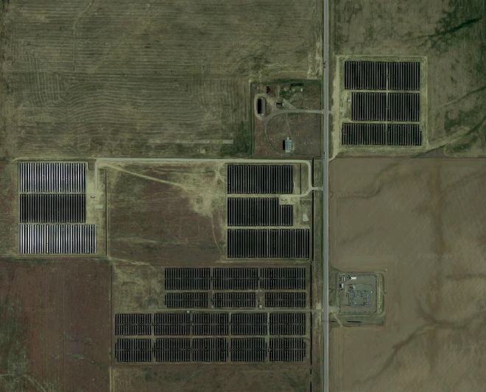
19

Slide 20
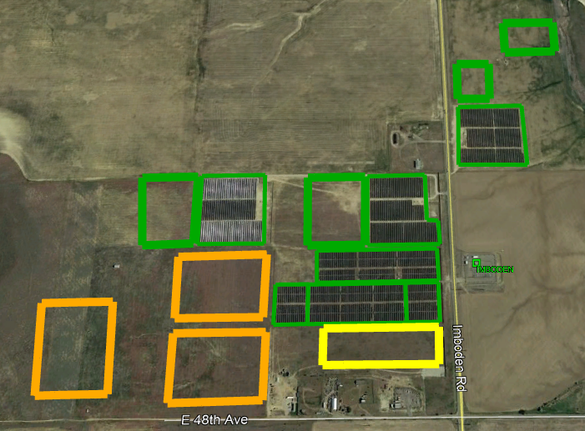
20

Slide 21
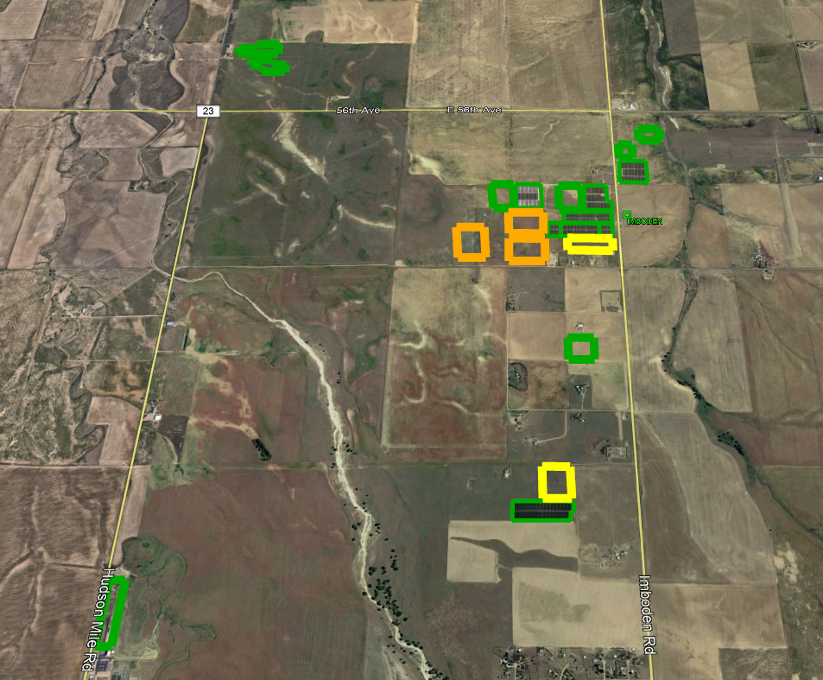
21

Slide 22
Rule 3667 Screens
The line section shall not exceed 15 percent of the lines section’s annual peak load
For Perspective
  Imboden Substation has reached 1,100 percent or 73 times the screen criteria!

Slide 23
Other General Information
Public Service owns and operates over 150 distribution substations
Nearly 1/3 of the active CSG MWs are interconnected at 1 substation, Imboden Substation

Slide 24
PSCo Developer Resources
Pre-Application Process
Hosting Capacity Maps
By Division Substation Maps
Minimum Daytime Load Study Report
Substation Distribution Generation Queue

